Slide 1
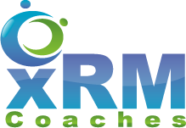
Dynamics 365: Learning what you need
POWER PLATFORM

Slide 2


Mitch Milam
mitch@xrmcoaches.com
@mitchmilam
linkedin.com/in/mitchmilam
youtube.com/xRMCoaches

Slide 3
Dynamics 365 Training
https://learn.xrmcoaches.com
Power Platform JavaScript Development
The Art and Science of Model-Driven App Design
50% off through the end of April use code: inthistogether at checkout

Slide 4
Getting Started

Slide 5
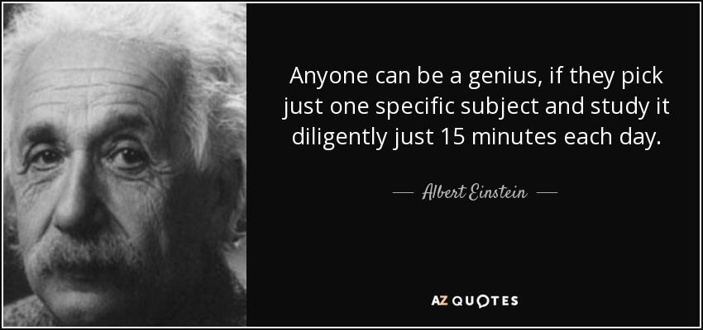

Slide 6
Stages of Knowledge (for Dynamics 365)
End User
Power User
Administrator
Customizer
Developer
Architect

Slide 7
End User
Know the product
Know how to accomplish a task (your job)
Know how to accomplish other people’s tasks

Slide 8
Power User
Builds on the end-user skills
Knows and understands advanced features
Helps others
Understands the business and it’s processes
Can create automation (processes)

Slide 9
Administrator
Builds on the power-user skills
Adds day-to-day administration abilities
Finds solutions to problems [you didn’t know you had]

Slide 10
Customizer
Can build on administrator skills
Creates new components
Basic development skills using JavaScript
Uses Power Automate

Slide 11
Developer
Builds on customizer skills
Fluent in the Dynamics 365 JavaScript object model
Can create plugins
Understands business processes and how to map them to Dynamics 365

Slide 12
Architect
Builds on all of the previous skillsets
Knows the product inside and out
Knows what features are generally best for any given requirement
Can translate business requirements into functional requirements
Can work with end-users and developers to define a solution

Slide 13
Education

Slide 14
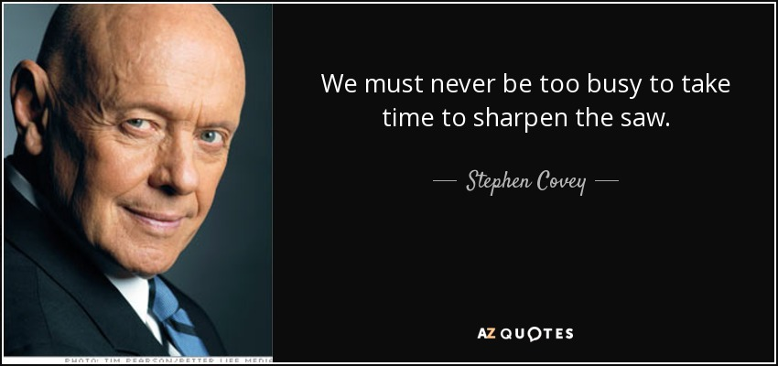

Slide 15
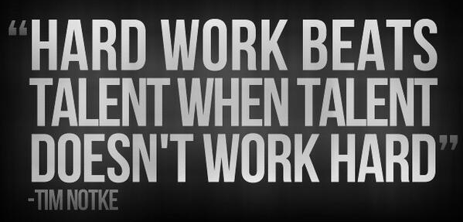

Slide 16
Resource Types
Websites and Blogs
YouTube
Books
Courses (on-demand, in-person)
Conferences (live and virtual)
User Groups

Slide 17
Useful Web Sites
Dynamics 365 User Group Blog Feed
www.crmug.com
Microsoft Dynamics Communities
community.dynamics.com
CRM Tip of the Day
crmtipoftheday.com
youtube.com/crmtipoftheday

Slide 18
My Training Resources xrmcoaches.com
Webinars
/webinars
KnowledgeBits
/knowledgebits
Learning Plans
/freestuff
YouTube Channel
youtube.com/xrmcoaches

Slide 19
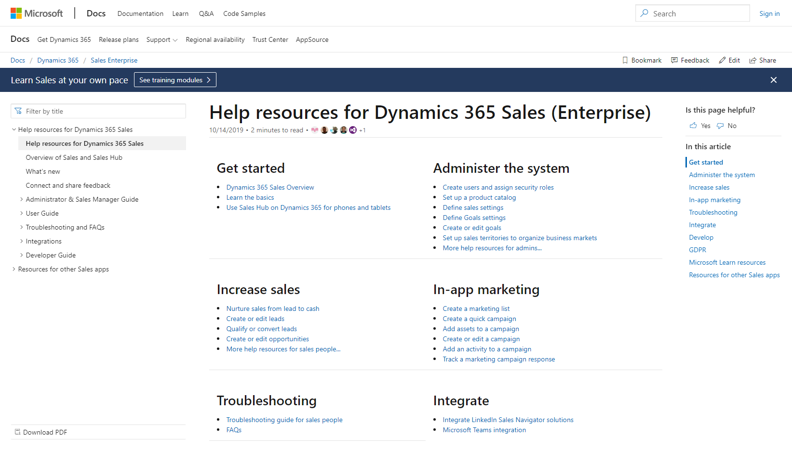
Help & Training

Slide 20
Define Your Path

Slide 21
Define Your Main Goal
Certification
Product knowledge
New job or career
You just like being the smartest kid on the block

Slide 22
Functional Curve
Task
Application
Function

Slide 23
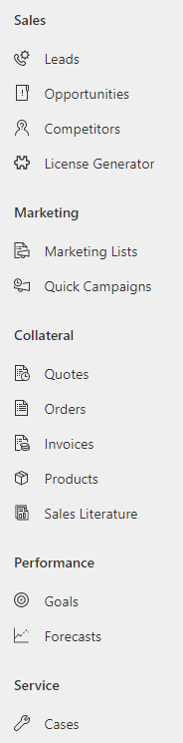
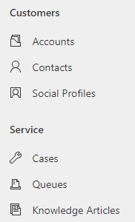
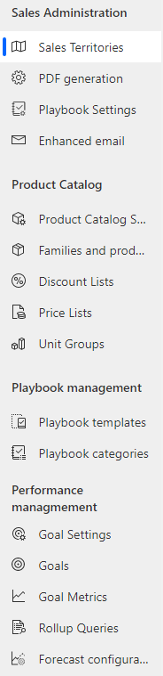
Learn By Function

Slide 24







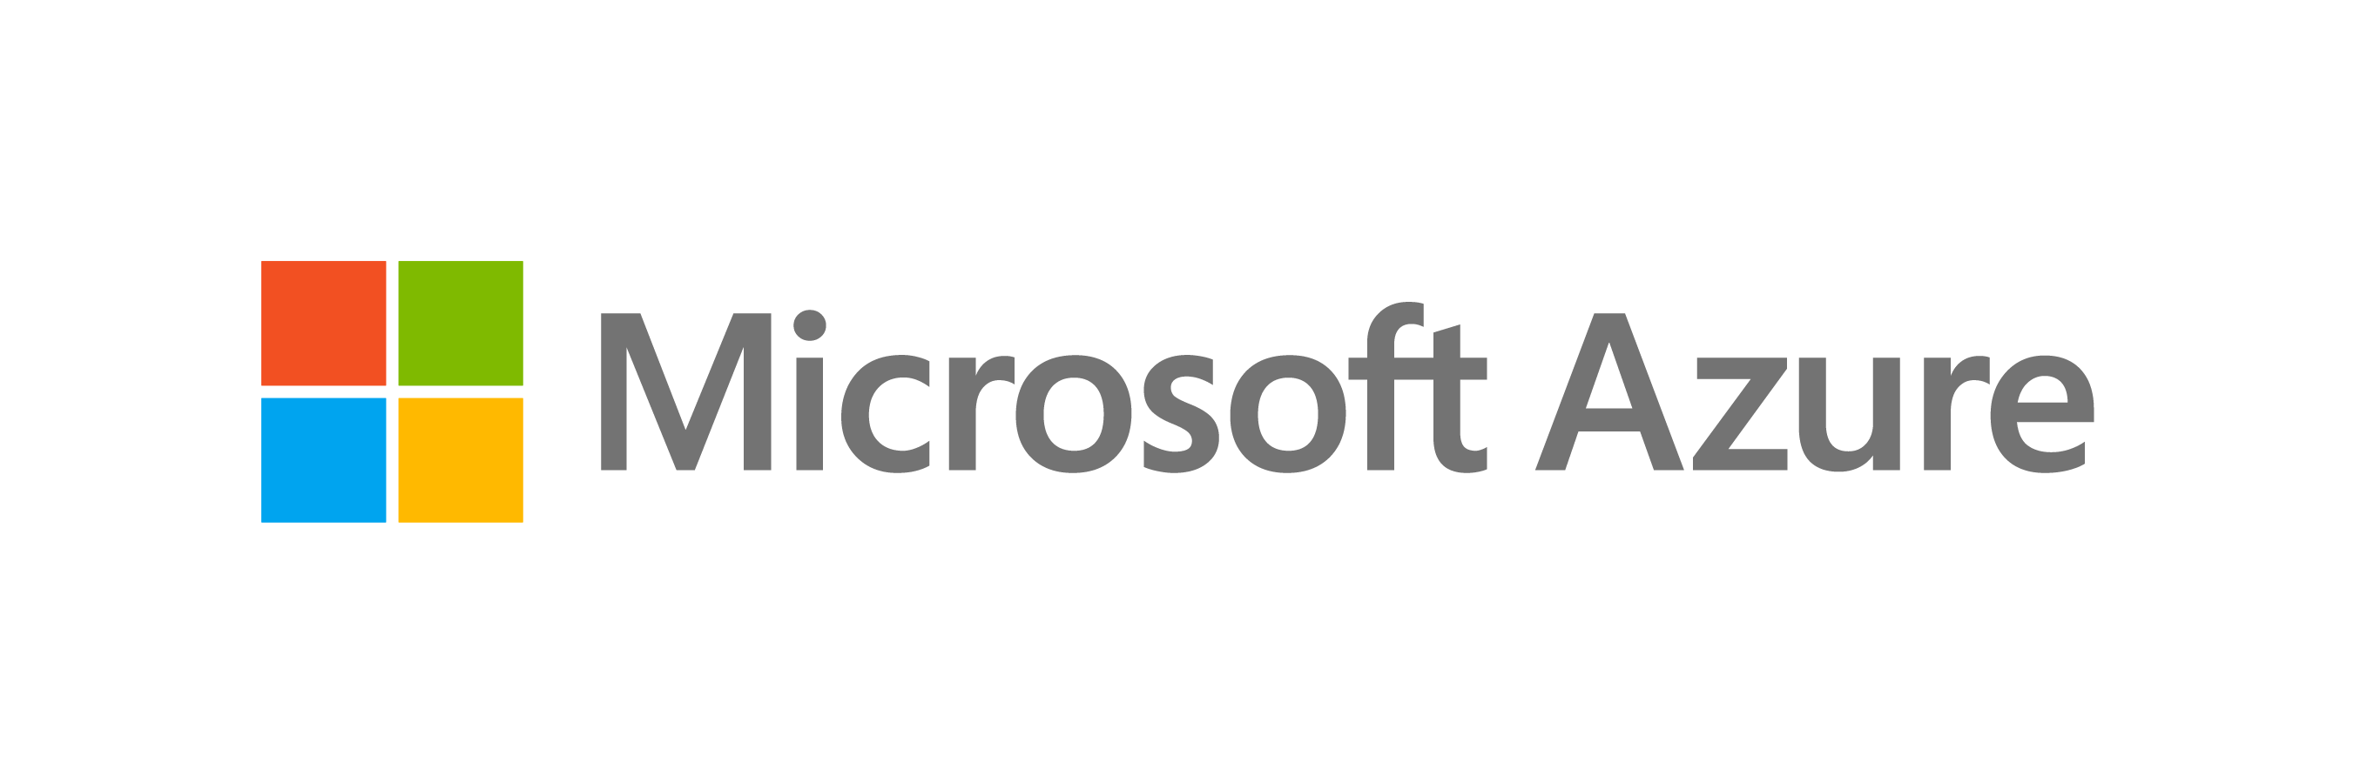




The Microsoft Cloud
Intelligence
Data
Marketing
Finance
Sales
MODERN
UNIFIED
INTELLIGENT
ADAPTABLE
Commerce
Customer Service
Human Resources
Field Service
Supply Chain Mgmt
Productivity and collaboration
Open, flexible, enterprise-grade cloud computing platform
Power Platform
Power BI
Power Automate
Power Virtual Agents
PowerApps

Slide 25

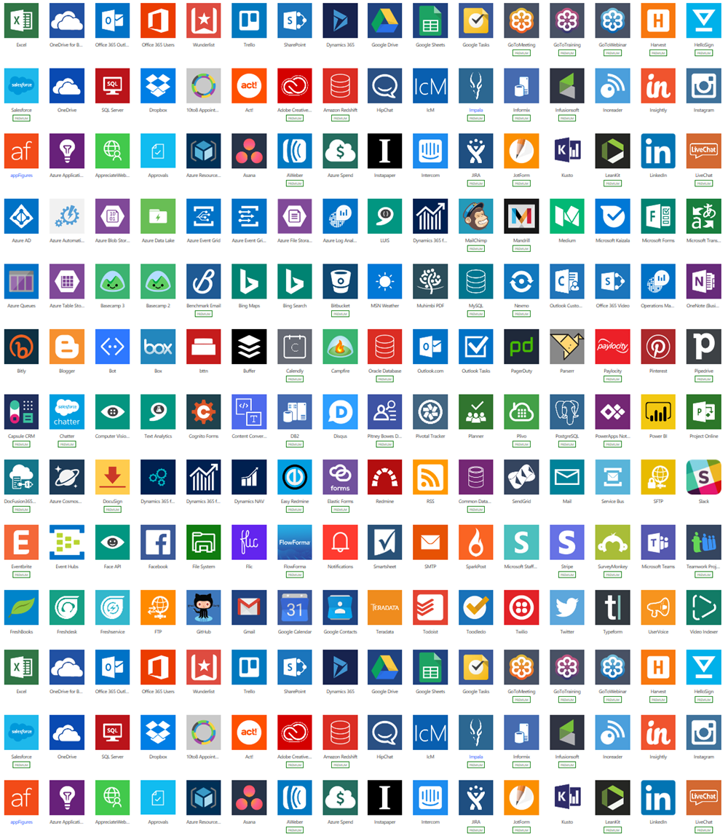
The Dynamics 365 approach to AI
PowerApps
Process optimization automation, and visualization
External
Ingest
Map and Match
Power BI
Power Automate
BEHAVIORAL
TRANSACTIONAL
DEMOGRAPHIC
Analytics
CONNECTORS
Customer Insights
Marketing
Finance
Systems of Engagement
Customer Service
AI and ML
Sales
Commerce
Conflate
Enrich
Talent
Field Service
Internal
Supply Chain Mgmt
Data
Unification
Insights
Action
Notes:
The potential of AI is exciting. However, while many business professionals recognize the potential for AI to boost efficiency or enhance the customer experience, they perceive implementation to be unrealistic for them.
Let’s see how we at Microsoft are changing that perception:
Data: Our Dynamics 365 approach to AI starts with Microsoft’s ability to source all your data from both internal and external sources through a set of 300+ out of the box connectors including On-Premises data gateways to support hybrid deployments. Microsoft’s ability to fast-track the data integration process from what has historically been a costly, error prone and multi-tech stack challenge allows organizations to easily overcome the first hurdle of successful AI outcomes; a lack of data.
Even more since basically today 1st of October you can bring data that is stored in the customer sdata lake. You can also bring in your own Data Lake as long as your data is in CDM compatible.
Customer Insights Entities are CDM compatible entities created by the system on your behalf; These entities are over Your data and you can export them and power other scenarios Like flow, Power Apps, etc.
Unification: Beyond the most basic need of AI being data, an organization needs to be able to make sense of that data. As you ingest multiple sources of data you will certainly detect errors, duplication and other common issues. Our unification process standardizes data and applies built-in AI to automatically match and merge the records into one comprehensive profile. In addition, organizations can create richer profiles with brand affinity and interests from Microsoft Graph which provides aggregated proprietary predictive signals.
Insights: Armed with a single source of truth, our customers leverage Microsoft’s industry leading: Analytic, AI and ML capabilities to unlock insights and achieve greater organizational outcomes. At Microsoft we have been leading the way in AI for decades, for example did you know that;
Microsoft has over 18 thousand (18,365) AI-related patents as of January 2019 leading all other companies with the most AI Patents.
Microsoft recently (June 6, 2019) surpassed the estimate for human performance on the overall average score on GLUE of nine Natural Language Understanding (NLU) tasks, including question answering, sentiment analysis, text similarity and textual entailment.
Microsoft is the only company offering organizations a no-cliffs extensibility offering when it comes to AI. Our customers utilize Microsoft’s out of the box (SaaS) Insights and then either extend those solutions or bring their own with our Azure (PaaS) offering.
Action: Whether you are working on structured business processes for Sales, Finance and Customer Service or building new Apps that don’t yet exist in your organization, Dynamics 365 uses AI as a core ingredient to enhance, not replace, the capabilities of business professionals by infusing AI in their everyday workflows. As your organization acts our AI process repeats it self based off every interaction you choose to include. Bringing all these services together as one vendor makes Microsoft best positioned to support your data, unification, insights and action needs.

Slide 26














What if we applied AI & BI to your sales journey…
Automate churn prediction
Discover
Use
Complete Purchase & Auto-provision select services
Retain
AI creates Sales Action Plan
Automated bill payments
Generate awareness & nurture leads
Leverage unified a Customer 360 profile
Customer 360
Field Technicians work queue is logged with status updates for visibility
Collect feedback & share satisfaction
Gain insights on your data & update required data assets & your CRM
Receive guidance from AI for cross-sell/ up-selI
AI
Field Technicians notified when order is approved
Engage
Enable guided selling process
Analytics & Reporting for management and customers
Explore
Deliver
Provide fully mobile intelligent field sales experience
Buy
Notes:
Imagine a seamless, personalized experience for your prospects and customers, in face to face engagements and online.
Imagine understanding your customer’s needs and supplying the right products and services at the right time.
Imagine representatives spending more time with customers, providing personalized assistance and incentives, which increases customer satisfaction and sales.
Imagine anticipating demand and effectively scheduling to meet that demand.
Imagine optimizing operations, reducing waste, and enabling your employees to make better decisions.
That’s the reality Dynamics 365 brings to your Customer Engagement landscape.
So let’s look at each one of the areas covered in this slide from the starting point of demand generation all the way to repeating business with existing customers.
Diving into each specific area we see how Dynamics 365 supports you;
Generating awareness
Generate more leads across multiple channels and nurture sales-ready leads with personalized experiences.
Key Dynamics 365 capabilities that support generating awareness are;
Account targeting (LinkedIn Sales Navigator integration)
Lead gen forms (LinkedIn integration)
Predictive lead scoring (Marketing & Sales)
Multi-channel campaigns (Marketing)
Events (Marketing)
Monitoring trends and reputation
Respond to trends faster with social and web insights that help you know what your audience is saying, seeking, and feeling.
Key Dynamics 365 capabilities that support monitoring trends and reputation are;
Email alerts (Market Insights)
AI-assisted query builder (Market Insights)
Bing web search rising topics (Market Insights)
Generating customer profiles
Unify your data across sources to get a single view of customers, optimize engagement, and discover insights that drive personalized experiences.
Key Dynamics 365 capabilities that support generating customer profiles are;
Data ingestion & standardization (Customer Insights)
Profile unification (Customer Insights)
Customer journey timeline (Customer Insights)
Data enrichment (Customer Insights)
Profile search & discovery (Customer Insights)
Business measures/KPIs (Customer Insights)
Delivering personalized ads and offers
Prioritize leads, automate hand-off, and empower sellers with shared information and connected processes.
Key Dynamics 365 capabilities that support personalized ads and offers are;
Dynamic segmentation (Marketing)
Website personalization (Marketing)
Multi-channel campaigns (Marketing)
Lead nurturing (Marketing)
PDF generation from Quotes (Sales)
Providing omnichannel experiences and engagement
Create positive experiences through any channel and on any device to exceed customer expectations.
Key Dynamics 365 capabilities that support providing omnichannel experiences and engagement are;
Power Platform connectors (Customer Insights)
Recommended actions (Sales Insights)
Portals (PowerApps Portals)
Virtual Agents (Virtual Agents for Customer Service)
Chat (Chat for Dynamics 365)
Digital Messaging (Digital Messaging for Dynamics 365)
Enabling guided selling
Focus on the right customers, build trusted relationships, and take swift action.
Key Dynamics 365 capabilities that support enabling guided selling are;
Connections & profile cards (LinkedIn Sales Navigator integration)
Who knows whom (Sales Insights)
Talking points (Sales Insights)
Relationship analytics & health (Sales Insights)
Recommended actions (Sales Insights)
Contact, account, opportunity management (Sales)
Live org chart (Sales & Sales Navigator integration)
Internal/external collaboration (Teams integration)
Meeting prep & wrap-up (Sales Insights)
Call intelligence (Sales Insights)
Playbook (Sales)
CPQ (3rd party solution integration)
3D experiences (Product Visualize)
Informing buyers throughout fulfillment
Differentiate your brand experience with faster, more personalized service that adds value to every interaction.
Key Dynamics 365 capabilities that support informing buyers throughout fulfillment are;
Portals (PowerApps Portals)
Notifications (Microsoft Flow)
Sales Orders (Finance & Operations)
Invoicing (Finance & Operations)
Driving faster time to value & satisfaction
Make it easy to find answers through self-service, communities.
Key Dynamics 365 capabilities that support driving faster time to value & satisfaction are;
Portals (PowerApps Portals)
Knowledges Articles (Dynamics 365 for Customer Service / Portal)
Communities (Dynamics 365 for Customer Service / Portal)
Forums (Dynamics 365 for Customer Service / Portal) Ideas (Dynamics 365 for Customer Service / Portal)
Blogs (Dynamics 365 for Customer Service / Portal)
Virtual Agents (Virtual Agents for Customer Service)
Chat (Chat for Dynamics 365)
Digital Messaging (Digital Messaging for Dynamics 365)
Surveys (Forms Pro)
Personalizing service interactions
Provide exceptional customer service and make better decisions to proactively improve customer satisfaction with confidence.
Key Dynamics 365 capabilities that support personalizing service interactions are;
Multi-channel campaigns (Marketing)
360 degree view of Customer Profile ( Customer Insights)
Portals (PowerApps Portals)
Virtual Agents (Virtual Agents for Customer Service)
Chat (Chat for Dynamics 365)
Digital Messaging (Digital Messaging for Dynamics 365)
Delivering incentives to strengthen loyalty
Increase customer loyalty by rewarding customers for their interactions.
Key Dynamics 365 capabilities that support delivering incentives to strengthen loyalty are;
360 degree view of Customer Profile ( Customer Insights)
Multi-channel campaigns (Marketing)
Next best Actions (Assistant / Assistant Studio)
Collecting feedback
Make it easy to capture and act on customer data.
Key Dynamics 365 capabilities that support collecting feedback are;
Surveys (Forms Pro integration)
Multi-channel campaigns (Marketing)
Recommending next-best products or services
Up-tell to discover and understand products and services that compliment the past purchase.
Key Dynamics 365 capabilities that support recommending next-best products or services are;
Quick-start machine learning templates (Customer Insights)
Next best Actions (Assistant / Assistant Studio)
Portals (PowerApps Portals)
Multi-channel campaigns (Marketing)
Automating churn prediction
Quick-start machine learning templates to predict churn and provide the next best action.
Key Dynamics 365 capabilities that support automating churn prediction are;
Quick-start machine learning templates (Customer Insights)
Bring your own AI (Azure AI / Azure Data Lake / Customer Insights)
Notifications of likely to Churn segments (Microsoft Flow / Customer Insights)

Slide 27

Don’t be overwhelmed

Slide 28
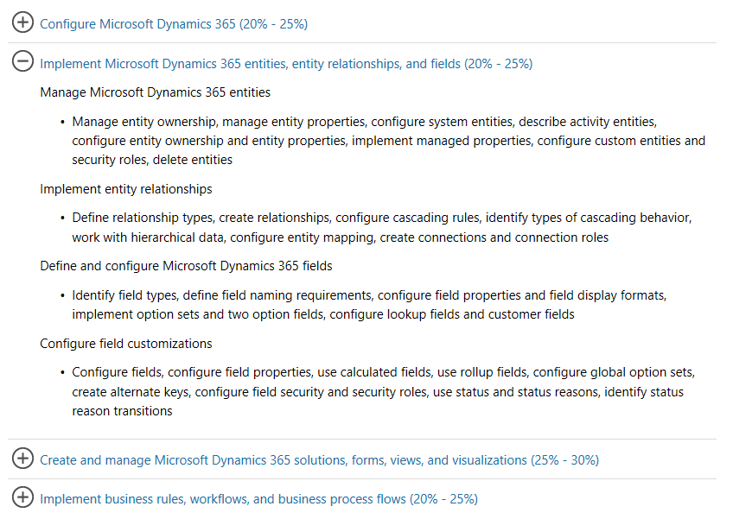
Certification as a Guide

Slide 29
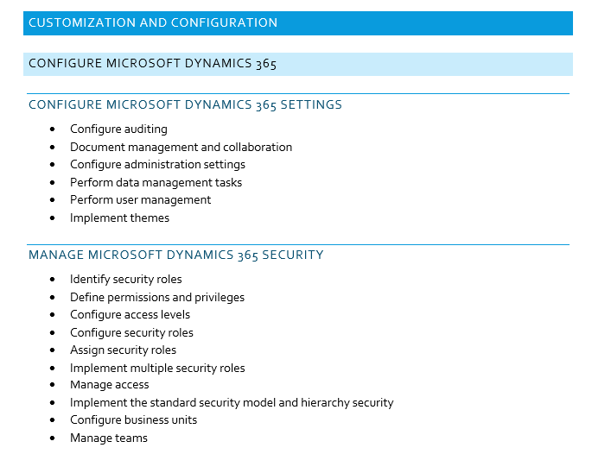
Sample Learning Plan

Slide 30
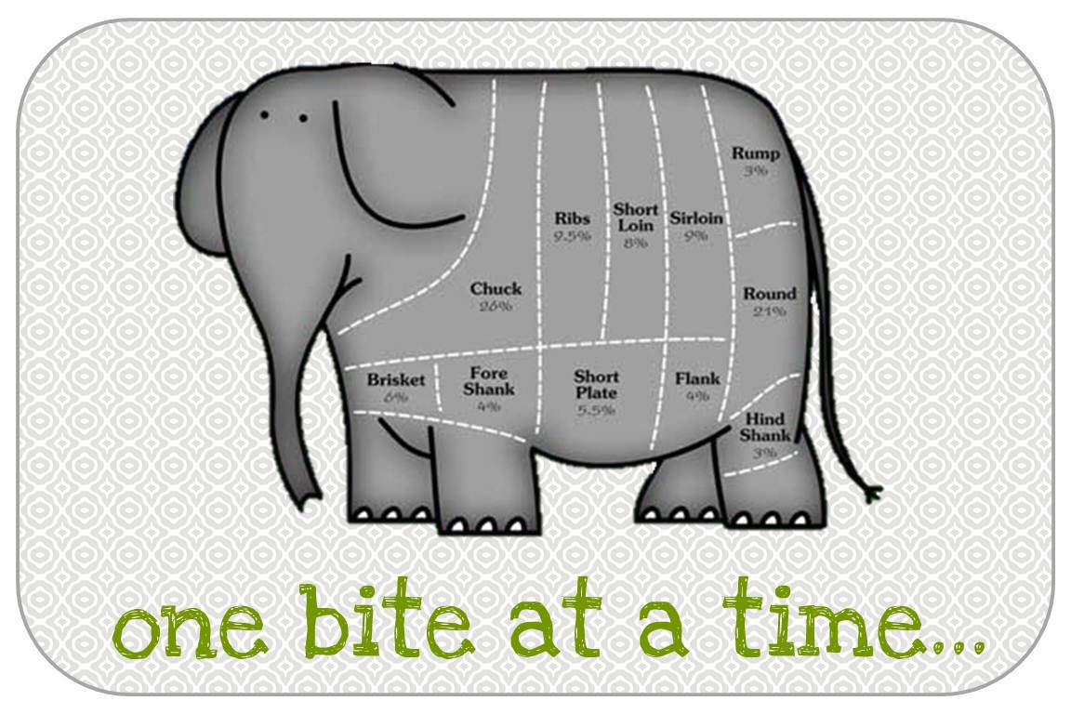
And Don’t Forget…

Slide 31
Tips and Tricks
Track and review your progress frequently
Start with functional areas you already know
Be consistent (block out time on your calendar)
Certification exams are a great way to test your knowledge (with a side-effect of getting a certification)

Slide 32
Learning in a Nutshell
Know
Comprehend
Understand
Teach

Slide 33
Exams and Certifications

Slide 34
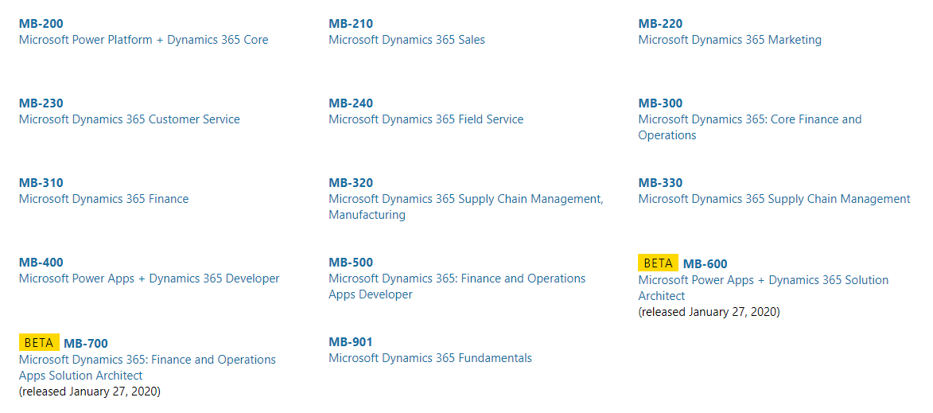
Current Exam List

Slide 35
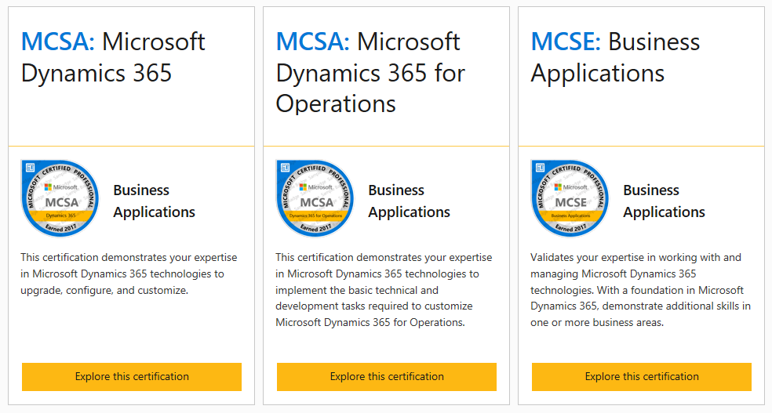
Certifications

Slide 36
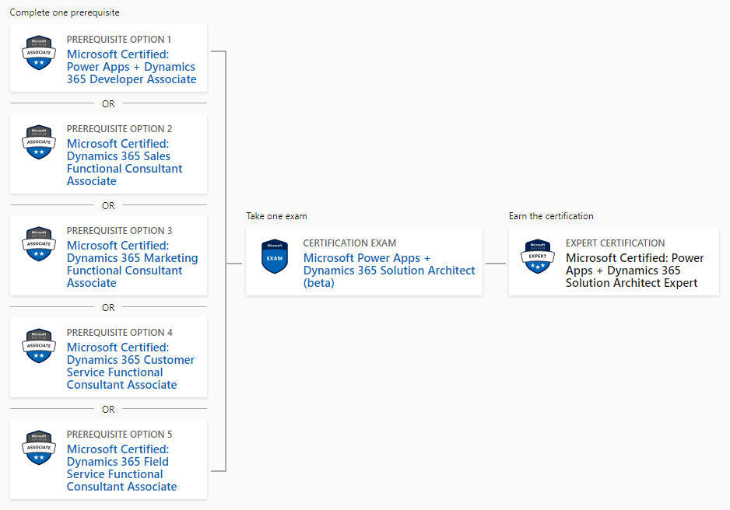
Power Apps + Dynamics 365 Solution Architect Expert

Slide 37
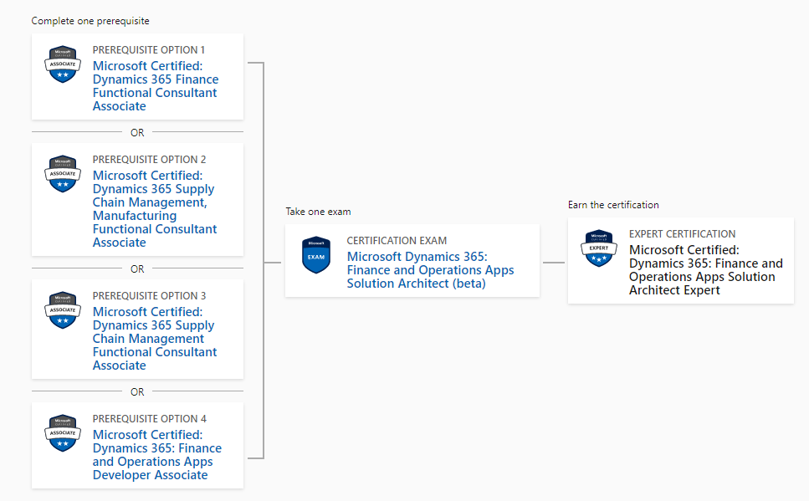
Finance and Operations Apps Solution Architect Expert

Slide 38
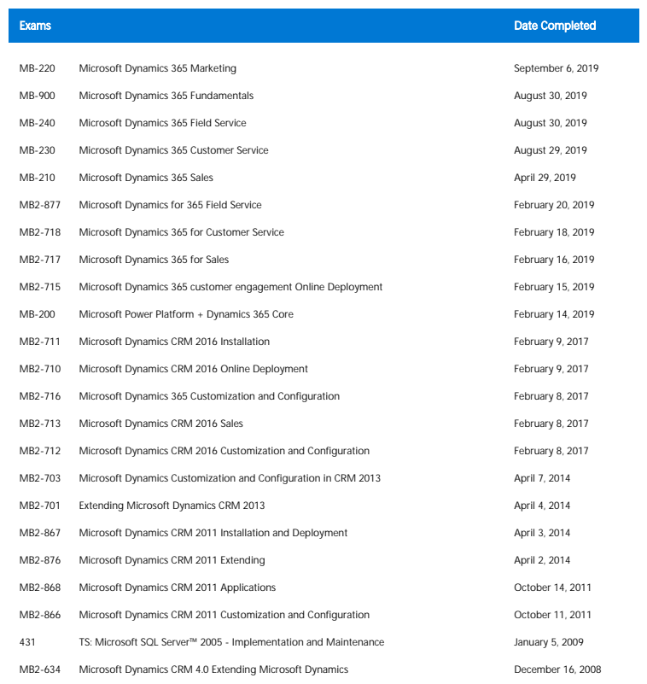
Mitch’s Exam History

Slide 39
Study Tips and Tricks
Establish a plan
Set a goal with a timeframe
Assemble your study resources
Get a study-buddy (if that helps)
Be committed
When in doubt, just go take the test

Slide 40
Study Tips and Tricks
It is only a test, so don’t be scared
What happens if you fail?
Do not over-study
There are plenty of free or low-cost learning aids

Slide 41
Testing Tips
Know you will pass
Remain calm
Manage anticipation
Don’t revisit your answers
If a question is badly written or confusing, mark for later review and provide feedback

Slide 42
Deliberate Practice

Slide 43
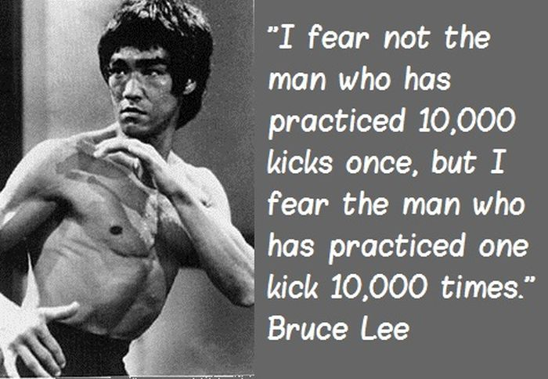

Slide 44


Slide 45
What about a test environment?
Sign up for a Dynamics 365 Online Trial
Use a sandbox environment (if you have one)

Slide 46
How To Ask For Help
Exhaust all possible options
Ask nicely
Don’t be offended if people don’t return your query
Don’t ask them to do an entire project for you, for free

Slide 47
Questions?

Slide 48
Thank You

